Slide 1
How to Measure Volume
PG 7 of your Science Notebook

Slide 2
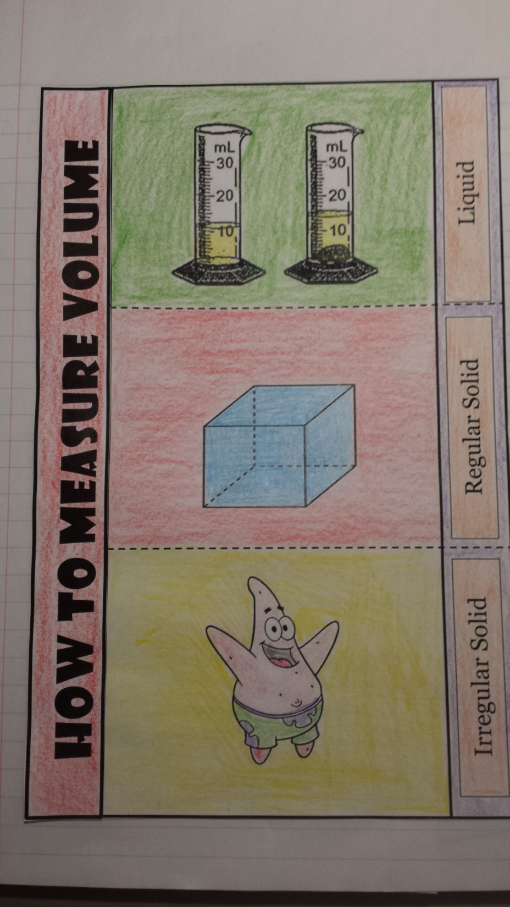
7

Slide 4
Use a graduated cylinder

Slide 5
Use a graduated cylinder
Measured in mL or L

Slide 6
Use a graduated cylinder
Measured in mL or L
Read the measurement at the bottom of the meniscus. Read at eye level.

Slide 8
Measure with a ruler or meterstick

Slide 9
Measure with a ruler or meterstick
Measured in “cubic units” like cm³

Slide 10
Measure with a ruler or meterstick
Measured in “cubic units” like cm³
Multiply length x width x height (v = l x w x h)

Slide 12
Measure the amount of liquid the object displaces

Slide 13
Measure the amount of liquid the object displaces
Measured in cm³ because 1 mL = 1 cm³. Only liquids should be measured in mL and only solids should be measured in cm³!

