Slide 1
Physical Properties of Matter

Slide 2
What are physical properties?
A physical property is a characteristic of a substance that can be observed without changing the identity of the matter.

Slide 3
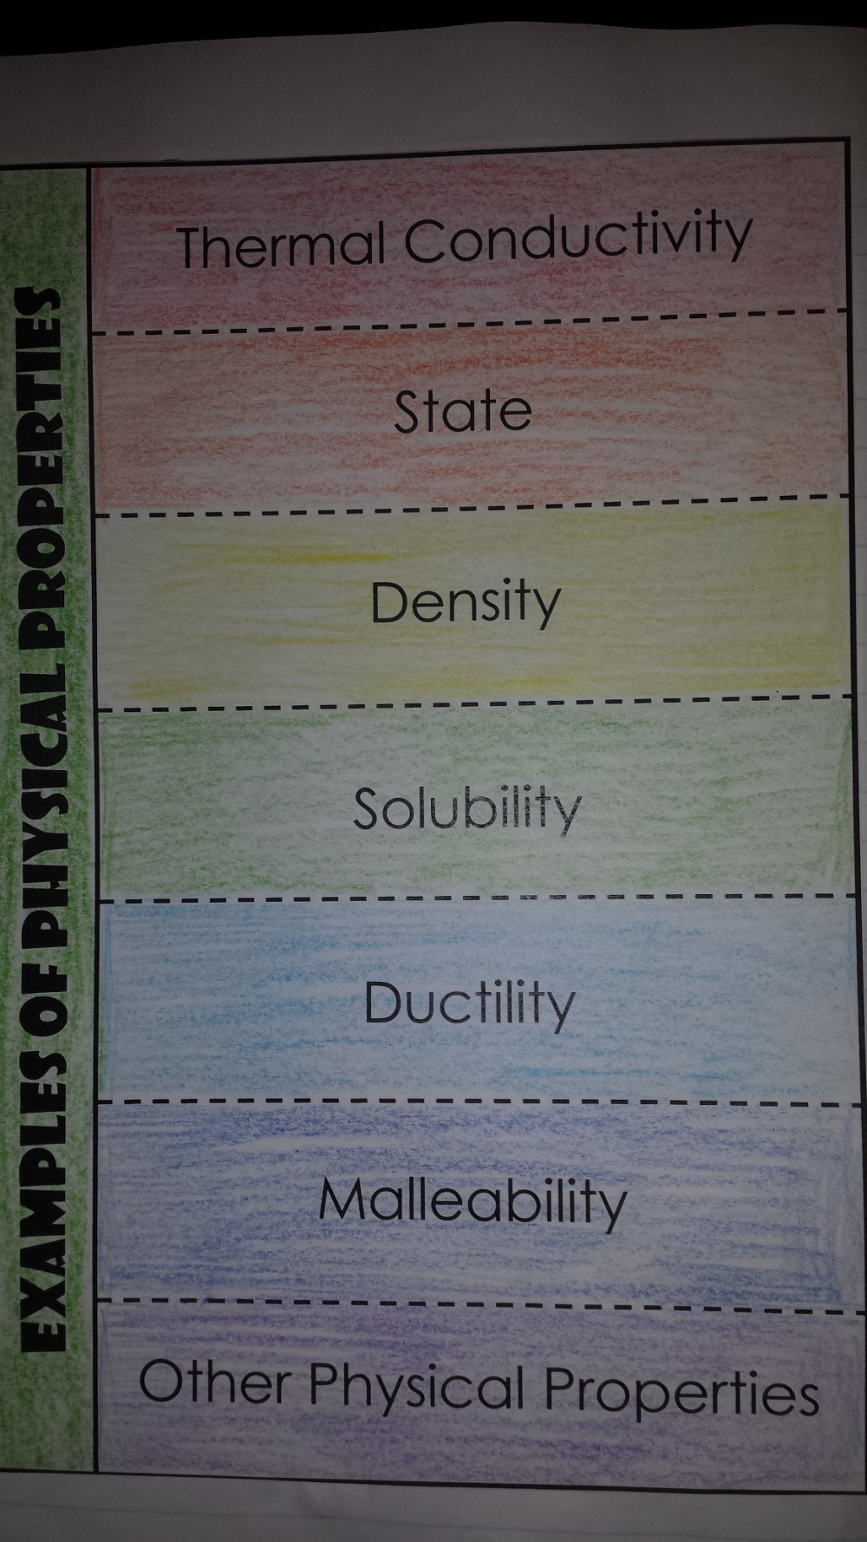
13

Slide 4
Thermal Conductivity

Slide 5
Thermal Conductivity
The rate at which a substance transfers heat.

Slide 6
State

Slide 7
State
The physical form of a substance (solid, liquid, or gas)

Slide 8
Density

Slide 9
Density
The mass per unit of volume of a substance.

Slide 10
Solubility

Slide 11
Solubility
The ability of a substance to dissolve in another substance

Slide 12
Ductility

Slide 13
Ductility
The ability of a substance to be pulled into a wire

Slide 14
Malleability

Slide 15
Malleability
The ability of a substance to be rolled or pounded into thin sheets.

Slide 16
Other Physical Properties?

Slide 17
Other Physical Properties?
Color
Odor
Sound
Magnetism
Volume

